Slide 1
SPL – PS1
Introduction to C++

Slide 2
Basic terminology and C++ functions
Functions in C++ are like methods in Java. However C++ functions don’t have to be a part of a class.
In C++ a function or a variable can be declared outside of a class. In that case we say it is in the global scope.
During this course, you should avoid declaring functions or variables in the global scope.
Like in Java, main is a unique free function name that will be executed on program start. It returns an int value, and receives the command line arguments. (int argc, char** argv)

Slide 3
C++ functions (cont)
A function definition contains both a prototype and a body. For example:
A function declaration contains only the prototype followed by a semicolon:
You can have multiple declarations of the same function but only one definition.
int add(int a, int b) { return a + b; };
int add(int, int);

Slide 4
Forward declarations and header files
A Forward declaration is a declaration of a variable a function or a class for which the programmer has not yet given a complete definition.
The compiler uses the declaration to determine how to generate the object code. (More on that later)
A header file (*.h) commonly contains forward declarations of subroutines, variables, classes and other identifiers. A C++ source file (*.cpp) will define behavior for identifiers.
Notes:
Identifiers that needed to be declared in more then one source file can be placed in one header file, which is then included whenever it’s contents are required.

Slide 5
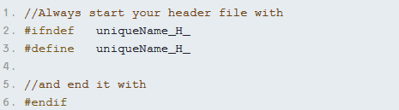
Header files (cont)
#include has the same purpose as Java’s import. However unlike Java, #include “copy-pastes” contents of the included file into the current file.
This is why you must be careful as to what you include. As a rule, include only header files.
Notes:
Beware of circular dependencies

Slide 6
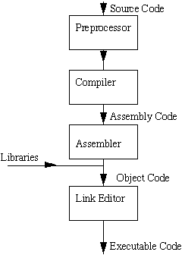
Compiling and Linking a C++ program
The preprocessor
The preprocessor accepts source code (*.cpp) as an input, and is responsible for:
Removing comments
Interpreting special preprocessor directives, denoted by #
Notes:
Examples of preprocessor commands : #include, #ifndef, #define..

Slide 7
Compiling and Linking a C++ program
C++ Compiler
The C++ Compiler translates source to assembly code. The source code is received from the preprocessor.
Notes:
Every soure file needs to be compiled separately.

Slide 8
Compiling and Linking a C++ program
Assembler
The assembler creates object code. On a unix system you may see files with a *.o suffix (*.obj on MS-DOS systems) to indicate object files.
Notes:
For us it’s part of the compiler.

Slide 9
Compiling and Linking a C++ program
Linker
The linker combines the code to create a single executable file.
External function and variable references are resolved by the linker.
The linker also looks for the main() function to mark it as the starting point of the executable.
The linker combines multiple object files (*.o) and libraries (*.a) into one executable.
Notes:
If a source file references functions defined in other source files, the linker takes care of that.

Slide 10
Differences from Java
Java | C++
Does only compilation. It has no assembler step, since it is not machine specific. | C++ compiler by default will do pre-compilation, compilation and assembler. | Compiler
Linking is done in runtime. Whenever execution of Java bytecode requires the presence of a new class then a class loader is invoked to fetch the class material. | C++ linker will link the object files to an executable. | Linker

Slide 11
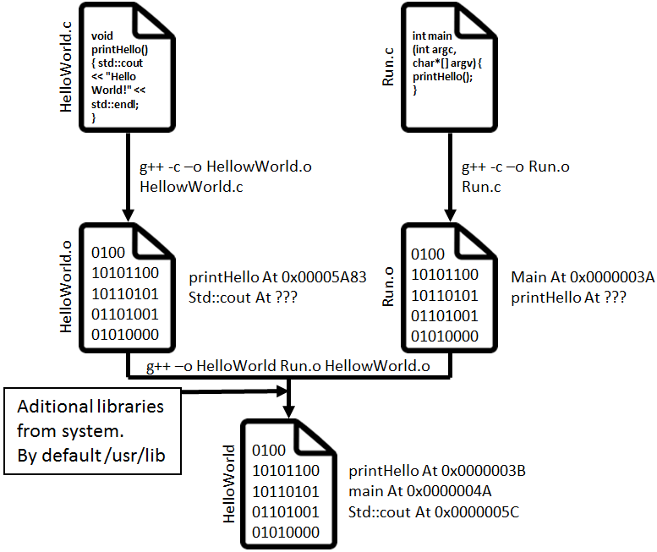

Slide 12
Compiling C++ manually
Open terminal
Go to project root
Clean:
Compile:
Compile:
Link:
Run:
Notes:
This is fine when we have one or two source files, but what should we do if we compile a program with a larger number of source files?

Slide 13
g++ Parameters
-o filename – Places output in filename. By default it will create a file called a.out
-c – Compile or assemble the source files, but do not link. The compiler output is an object file corresponding to each source file.
-Ldir – Add directory dir to the list of directories to be searched for.
-llib – Use the library named lib when linking.
-O – Optimize. Use this to yield optimized code.
-g – Add debug information.
-W – What warning level would you like to receive.
Notes:
No need to remember these parameters.

Slide 14
Makefiles
Makefiles are used to specify dependencies between abstract targets, and what needs to be done to achieve each target.
Target name and dependencies are assumed to be files.
Consider a simple target $T_1$, which depends on $D_1$ and $D_2$. To build $T_1$ the make utility will work as follows:
If either $D_1$ and $D_2$ do not exist, build them (recursively)
Check if both $D_1$ and $D_2$ are up to date. If not, build them.
Check the date of $T_1$. If $T_1$ is at least as new as both $D_1$ and $D_2$ we are done.
Otherwise, follow the instructions given to build $T_1$

Slide 15
Makefiles (cont)
When you type “make” in your shell, the script will look for a file “makefile” in the same directory and will execute it, using the rules defined in the “makefile” file.
By default, make will execute only the first target in the makefile. So make sure the first target causes a complete build.

Slide 16
Makefiles
T1
instructions
D1
D2
instructions
instructions
D3

Slide 17
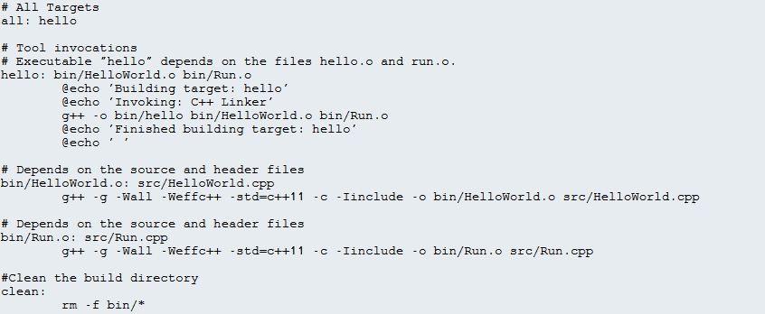
Makefile example

Slide 18
Makefiles
all
hello
g++ -o bin/hello bin/helloWorld.o bin/run.o
helloWorld.o
run.o
g++ -g –Wall –Weffc++ …
g++ -g –Wall –Weffc++ …
helloWorld.cpp
Run.cpp
clean
rm –f bin/*

Slide 19
C++ types
C++ has primitive (built-in) types. For example : int, double, long, bool, char
C++ uses the const keyword, instead of Java’s final.

Slide 20
C++ standard library
A collection of classes and functions written in the core language, and is part of the C++ standard. It contains 4 major components:
Algorithms – Such as binary search or lower bound.
Containers – Such as vectors, set, stack, map, queue, etc…
Functional – Set of class templates for function objects (Function wrappers). We will discuss templates in a later class.
Iterators – Iterators for STL containers.

Slide 21
C++ strings
The C++ string type is called string. It comes under the namespace std. (We will elaborate on namespaces later)
It is quite similar to the Java String, although there are a few differences:
Java | C++
Immutable | Can be modified.
Comparison is done using the methods equals() and compareTo() | Comparison is done using the operators == <= >= < > (lexicographic order)

Slide 22
C++ vector
Vector also comes under the namespace std.
The C++ vector combines the best features of arrays and vectors in Java.
A C++ vector has convenient element access (random access).
It grows dynamically.
If T is a type, then vector<T> is a dynamic array of elements of type T.

